Slide 1
Multivariate Linear Regression Modelling in R
Submitted BY: Mansi

Slide 2

Case Study 2- Hyundai Elantra
Objective: To build an analytical model to predict monthly sales of the Hyundai Elantra in the United States
Business Problem: To analyse using the given sales data that which all factors play a key role in predicting the monthly sales of Elantra in the US.
And consequently interpreting the relationship between the significant variables and the monthly sales.

Slide 3
About the data
Each observation is a month, from January 2010 to February 2014.
There is a total of 7 different variables which include:
1) Month | Month of the observation
2) Year | Year of observation
3) Elantra Sales | Units of Elantra sold in that particular month of that year in the US
4) Unemployment | Unemployment percentage in the US in that month
5) Queries | Normalized number of Google searches for “Hyundai Elantra”
6) CPI_Energy | Monthly consumer price index for energy
7) CPI_All | Consumer price index for all months

Slide 4
Observations from data
It is visible that sales of Hyundai Elantra have seen huge increments over the years. Since we just have the data of January 2014, we cant compare 2014 with others. Whereas, on comparing the monthly consumer price index, we witness no drastic changes in it over the years.

Slide 5
Methodology
We first build a linear regression model to predict monthly Elantra sales using only Unemployment, CPI_all, CPI_energy and Queries as the independent variables. We use only the data before 2012 as our training data. We then do various iterations to remove the insignificant variables at 90% confidence level i.e. p=0.10
We then build another linear regression model, adding Month to the list of independent variables so as to incorporate the chances of monthly seasonality, keeping “month” as factor variable.
Various diagnostic tests are performed on the final model to check its explanatory power.

Slide 6
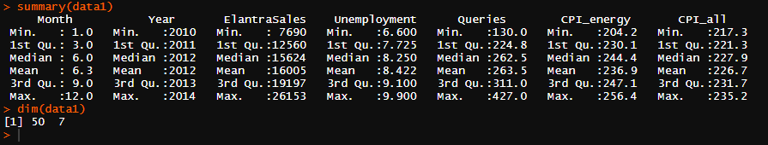
Description
Here, statistical inference can be drawn for 50 data points having 7 variables. Sales over the years is uniformly distributed, since the mean and median are close. Similarly for “unemployment” there exist no outliers.
Same is the case with all other variables. We can state the same while looking at the quantiles. Therefore, NO outlier treatment required.
Quantiles

Slide 7

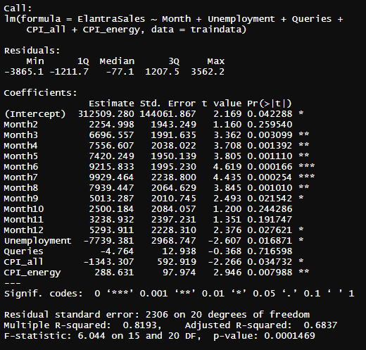
Modelling
In the final regression model, we find:
month,
unemployment,
CPI_all,
CPI_enrgy
as significant variables at 90% confidence level. Almost 82% of the variations in sales of Elantra sales can be accurately predicted by these independent variables.

Slide 8
Statistical Interpretation
Of all the significant variables, unemployment and CPI_all negatively affect the monthly sales of Hyundai Elantra. This can be observed by the negative estimates of these two variables i.e. -7739 and -1343 respectively.
A point to note here is that the negative coefficients are very large in absolute values which indicate that there is huge drop in Elantra sales with even slight increase in these two.
On the other hand, CPI_energy positively affects the monthly sales of Hyundai Elantra. For every one unit increase in CPI_energy, the sales increase by 288 times.
The p value is sufficiently low depicting higher significance of the variables in explaining the monthly Elantra sales leading to more parsimonity.

Slide 9
Business Interpretation
All the months have a coefficient which is positive and greater than 1 when compared to base month January. This implies that sales of Elantra in those 11 months is greater than that in January of every year.
However, CPI_ all has negative effect on the buying of Elantra cars.
CPI_all rises when there is inflation. As can be judged from psychological factors, inflation will lead to decrease in sales.
Similarly, if the unemployment rate is high, the buying capacity of consumers will tend to decrease.

Slide 10
Recommendation
During deflation, the Elantra sales will tend to increase. So, market economics play a major role. A close watch on it will help the business.
Of all the months, most significant relation has been observed in the 6th and 7th month of the year i.e. June and July. Hence, most schemes and offers should be provided to customers during these months.

